Slide 1

INDIAN INSTITUTE OF SCIENCE, BANGALORE
COURSE PROJECT: CP230 Motion Planning for Autonomous Systems
Efficient Path Planning for Quadrotor/Mobile robots
using RRT with Safety certificates
Bonus Problem: Path Planning for Multi-agent system deployed to carry a fragile object to avoid Static Obstacles and reach Static Goal
Paper: Efficient collision checking in sampling-based motion planning via safety certificates
Joshua Bialkowski, Michael Otte, Sertac Karaman and Emilio Frazzoli
Group 10: 1) Lokesh Bansal 2) Vishwas BC 3) Suprakas Saren
Teaching Assistant: Mr. Amit Kumar
IISc Bangalore
Course Project
CP 230 Motion Planning for Autonomous Systems

Slide 2
Efficient collision checking in sampling-based motion planning via safety certificates
Computational bottleneck (collision checking) in sampling-based motion planning algorithms.
Safety check has helped to reduce the computational complexity for collision checking.
Expected time spent on collision checking per iteration approaches zero (as the number of iterations approaches infinity)
IISc Bangalore
Course Project
CP 230 Motion Planning for Autonomous Systems

Slide 3
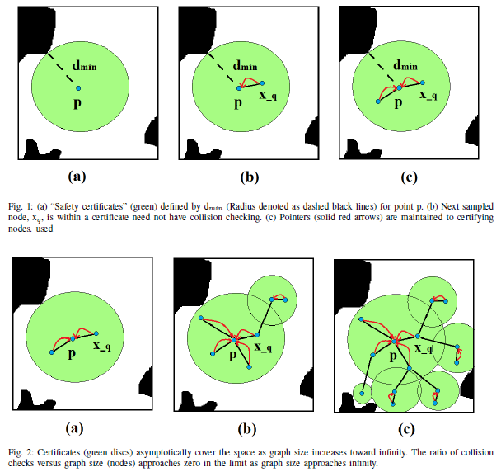
IISc Bangalore
Course Project
CP 230 Motion Planning for Autonomous Systems

Slide 4
Implementation
Main Interface
Controller
Modified RRT
V-REP
Modified RRT
Give a trajectory from start to goal
The waypoints of the trajectory are stored as csv file and would be called by main function
Controller
PD controller to track the trajectory given by the Modified RRT
V-REP
An environment with obstacles is created
Connect V-REP to MATLAB

Slide 5
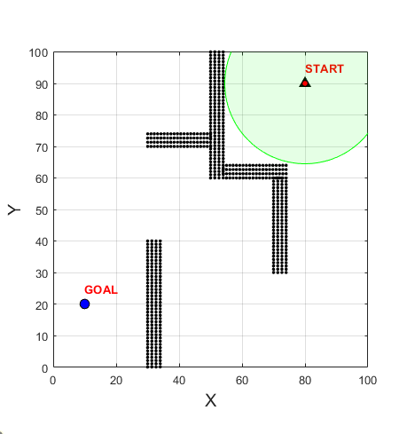

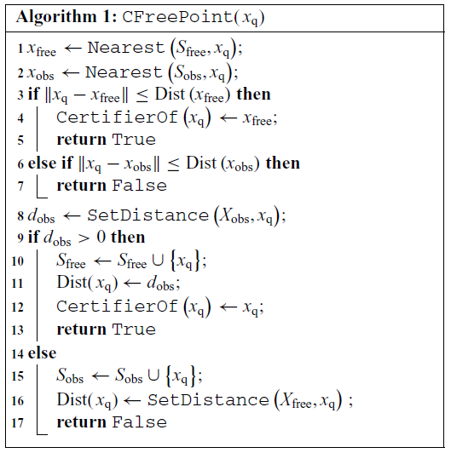
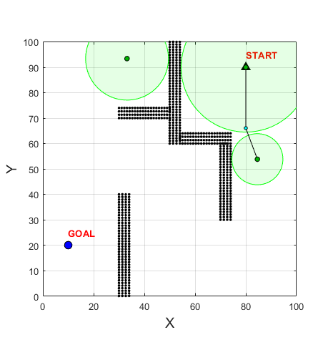
Fig.3 Step-by-step implementation of algorithm 1
IISc Bangalore
Course Project
CP 230 Motion Planning for Autonomous Systems

Slide 6
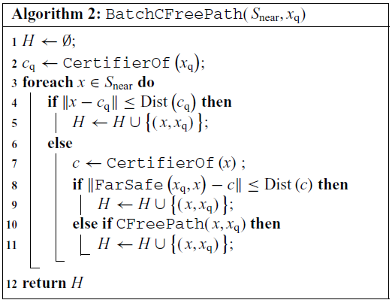
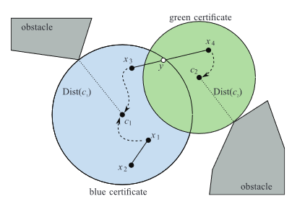
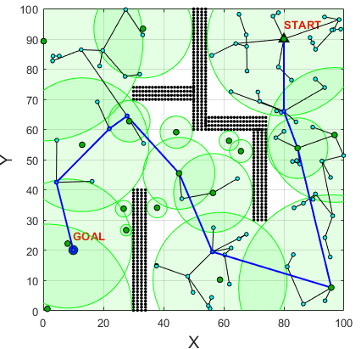
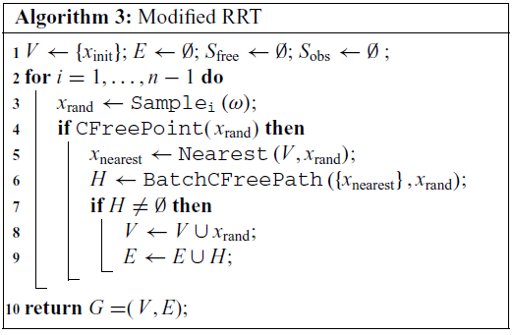
Fig.4 Step-by-step implementation of algorithm 2 and 3

Slide 7
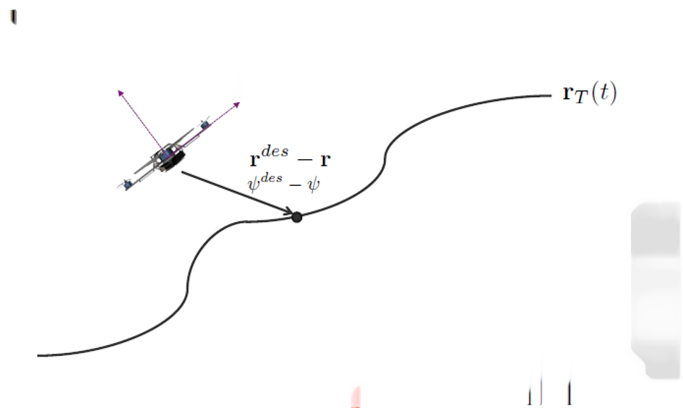
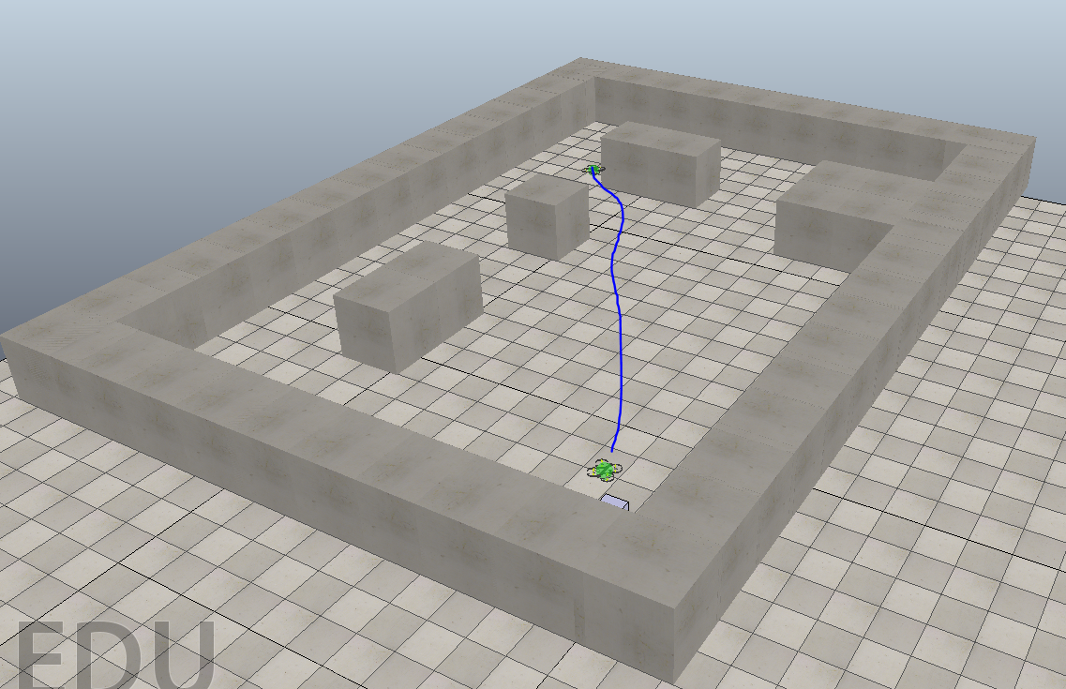
Path Planning for Quadrotor: RRT with Safety Certification
Figure 5: PD Controller for trajectory tracking with 6DOF Quadrotor Model
Figure 6: Avoid Static obstacles and reach a static target
Objective
Implement RRT with Safety Certification for collision checking to generate trajectory by avoiding static obstacles and reach static target
Implement 6 DOF Quadrotor with PD Controller for trajectory tracking for Quadrotor
Simulation in MATLAB and CoppeliaSim (V-REP)
IISc Bangalore
Course Project
CP 230 Motion Planning for Autonomous Systems

Slide 8
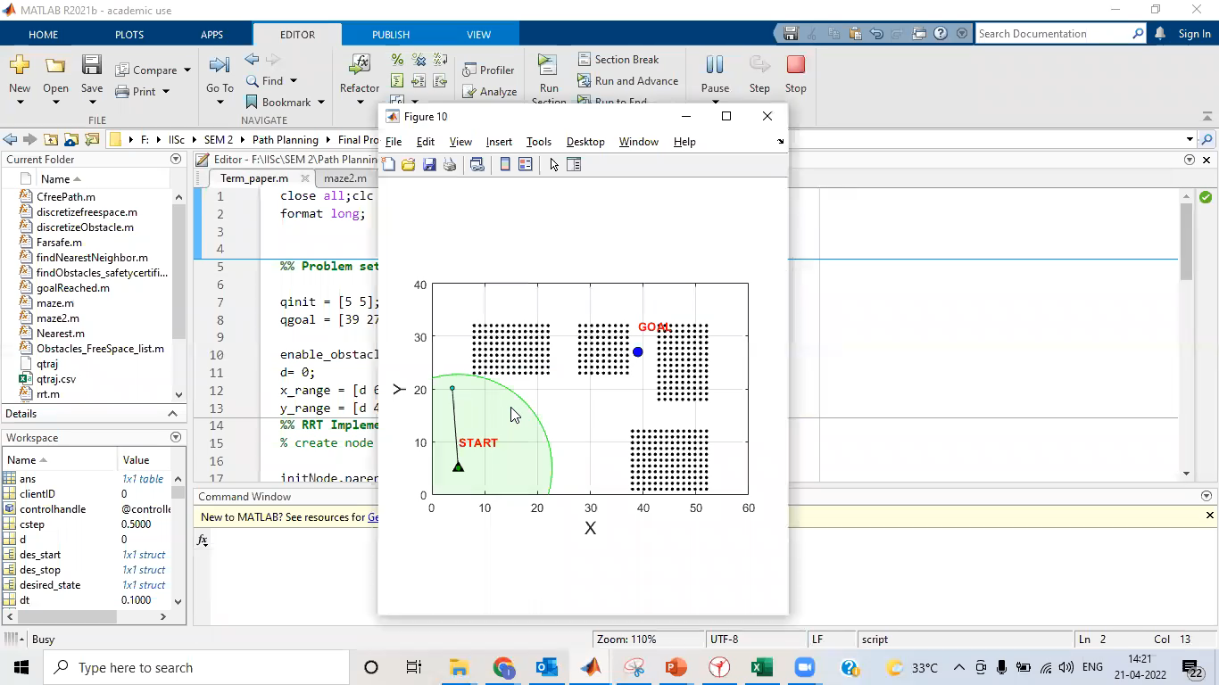
Modified RRT: Efficient Collision checking in node sampling
Figure 7: Efficient node sampling
Green circles are the safety certificates
If any newly sample node lies inside the green circle, it is implicitly declared to be collision free
Explicit collision check need to perform if newly sample node doesn't lie inside the green circles

Slide 9
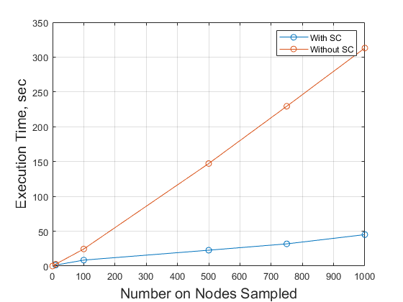
Execution time comparison of RRT(w/o SC) and Modified RRT with SC
SC: Safety Certification
Figure 8: Efficient node sampling
In absence of goal node:
100, 500, 750 and 1000 nodes are sampled with SC and without SC
Observed: Execution time of RRT algorithm reduced significantly

Slide 10
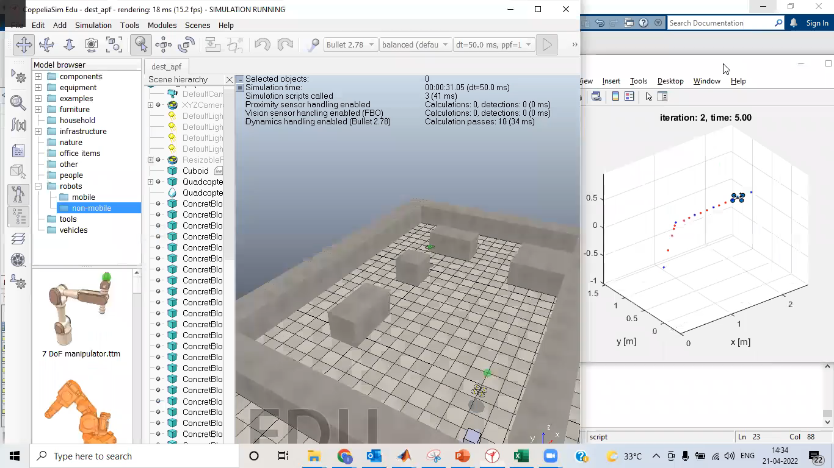
Path planning for Quadcopter with Modified RRT
Fig. 9: VREP Simulation with Quadcopter
Fig. 10: Matlab Simulation with 6 DOF Quadcopter

Slide 11
Bonus Problem
Objective:
The modified RRT algorithm is valid for a point mass system without considering the robot’s dimension.
This algorithm need to further modified to plan a collision free path for a multiagent system deployed to carry a fragile object of fixed dimension.
The objective is to get a obstacle free path for the whole system (multiple robots + fragile object).
Environment Considered for the Problem:
A grid map is assumed as a warehouse with static obstacles and goal location.
In the grid two ground robots are deployed to carry a fragile object of largest dimension ‘L’
Goal and start locations are static and assumed to be collision free

Slide 12
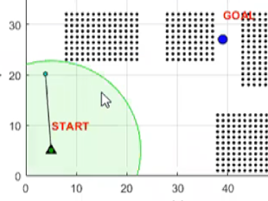
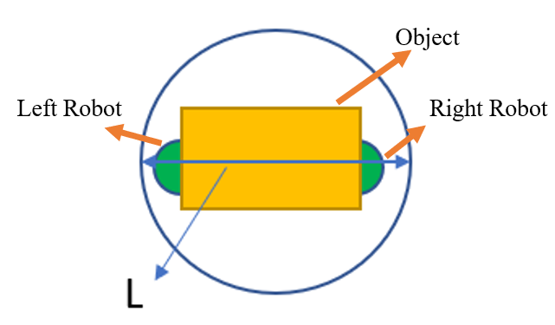
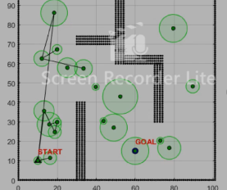
Bonus Problem - Solution
Two robots are chosen moving in a fixed formation to carry a fixed dimension object.
The two robots can be placed, underneath the object with largest dimension L.
We consider a circle of diameter ‘L’ around the centroid of the formation.
Now, we can modify the above algorithm as follows:
For drawing circles for safety certificates safe region is modified
Instead of taking the radius of safety certificate greater than 0, radius must be greater than L
If sampled node is not at least L unit away from an obstacle we consider this node to be invalid
Fig. 11: Safety certificates are 0
distance apart from obstacles
Fig. 12: Two robots carrying
fragile object
Fig. 13: Safety certificates are L
distance apart from obstacles

Slide 13
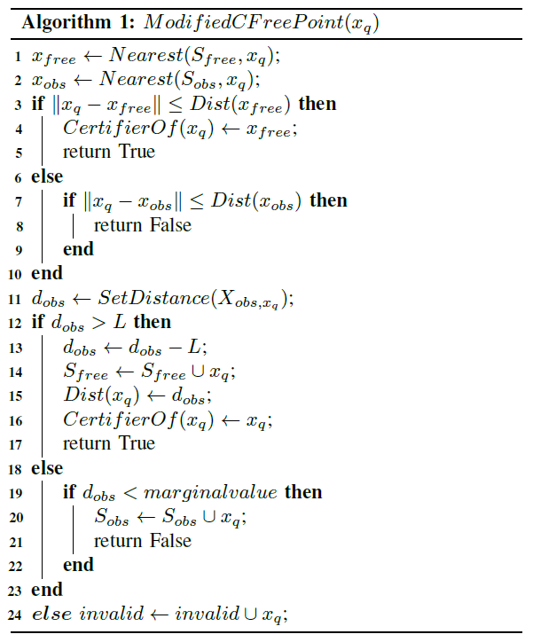
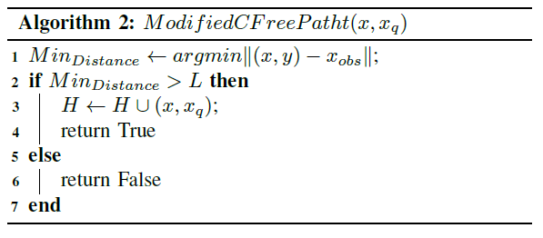
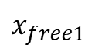
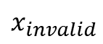
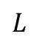
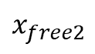
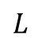
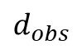
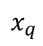
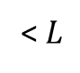
Bonus Problem - Solution
$$d_{obs}$$
$$x_{q}$$
$$x_{free1}$$
$$L$$
$$L$$
< $L$
$$x_{free2}$$
$$x_{invalid}$$
Fig. 14: Safety Certificates formation for multi-agent systems path planning

Slide 14
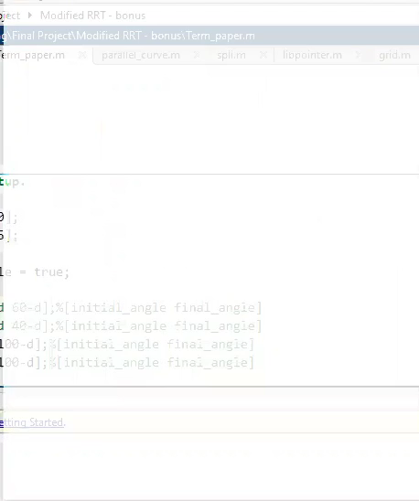
Path Planning for Multiagent system deployed to carry a fragile object to avoid Static Obstacles and reach Static Goal using RRT with Safety Certification
Fig. 15: Node Sampling
Formation Control for Multiple robots deployed to carry a fragile object from start to goal
Safe path planning for the robots along with the object carried by the robots
Modified RRT is giving safe path for the centroid of the formation of two robots

Slide 15
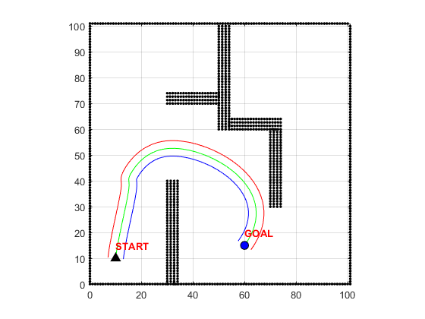
Confidence Interval
The two robots can take any path in between red and blue paths
Green path is the path of the centroid of the multi-robot assembly, this path is generated by the modified RRT

Slide 16
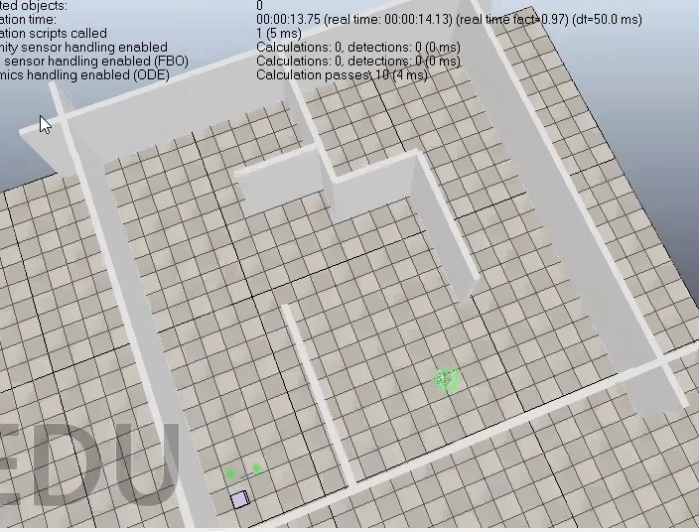
Path Planning for Multi-robot assembly deployed to carry a fragile object to avoid Static Obstacles and reach Static Goal using RRT with Safety Certification
Fig. 16: VREP Simulation: two robots supposed to carry a fragile object
Modified RRT is used to give safe path from start to goal in static environment
Simulation CoppeliaSim (V-REP)

Slide 17
Thank You

